Slide 1

Solar Power Coverage
Data analysis using Machine learning techniques
Github link :https://github.com/RajShekhar1290/Solar-Power-Cover-Analysis

Slide 2
Introduction
Solar power transformation in 21st century.
Deep Solar is a comprehensive high-fidelity solar deployment database for the contiguous U.S that is based on the machine learning framework.
Deep Solar database is a solar installation database for the US, built by extracting information from satellite images.
We will be applying different machine learning models for predicting the power coverage in the form of solar panel count based on satellite imagery data.
DataSet: http://web.stanford.edu/group/deepsolar/home.html

Slide 3
EDA Challenges
Variable Identification
Univariate Analysis
Bi-Variable Analysis
20,377 Records
3 Categorical
77 Continuous
Histogram for Continuous
Bar Char for Categorical
Continuous & Continuous
Continuous & Categorical
Categorical & Categorical

Slide 4
Exploratory data analysis
Detecting / Treating
missing values
Detecting / Treating
outliers
Variable Selection
Replaced missing values with mean value of column
Removed few outliers and used treatment like imputing.
Logistic Regression : BIC Criteria
Hypothesis Testing
Correlation between variables
Data Structure

Slide 5
Algorithm block diagram

Slide 6
Model Fitting
1) Random Forest : used ‘randomforest’ function in R
Error Rate Plot Confusion Matrix
Classification Trees : used ‘rpart’ function in R
Tree plot Confusion Matrix

Slide 7
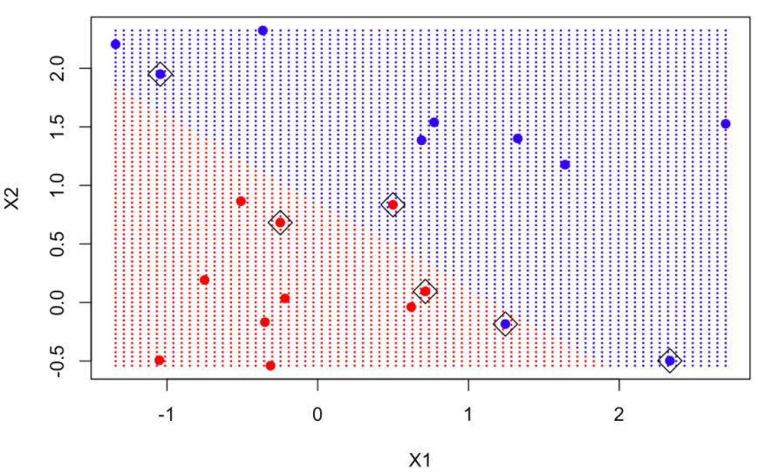
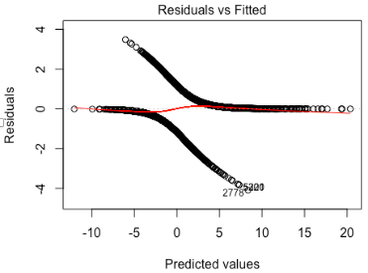
3) Support Vector Machines : used ‘kvsm’ function in R
Confusion Matrix Hyperplanes Plot
4) Logistic Regression: : used ‘glm’ function in R
Confusion Matrix Residual vs Fitted Plot
5) Bagging: function ‘bagging’ in R 6) Boosting :
Confusion Matrix Confusion Matrix

Slide 8
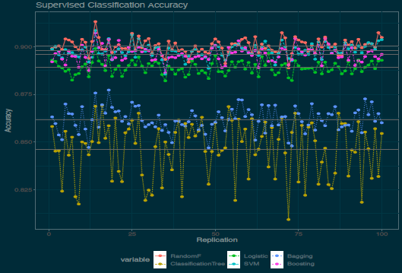
Model Prediction and Accuracy

Slide 9
conclusion
Study suggested that different models perform distinctively on the same data and the model that predicted solar power system coverage most accurately and provides a good balance between precision and overfitting is Random Forest.
IMPACT :
Population density, employment rate etc are among the many factors that may contribute towards the solar power coverage and goal is to identify and enhance them.
The response variable that is of our utmost interest is solar_system_count and we have correctly identified areas that have low count and can be looked into to have focused development in those areas for solar coverage development.

Slide 10
Thank you
Raj shekhar

